Slide 1
QUIZ NIGHT

Slide 2
Round 1
THERE CAN BE ONLY 1
Round 1 is in two parts, each has five questions.
The answers to part 1 are all ONE letter.
5 questions total. 1/26 chance to get it right if you don’t know it!

Slide 3
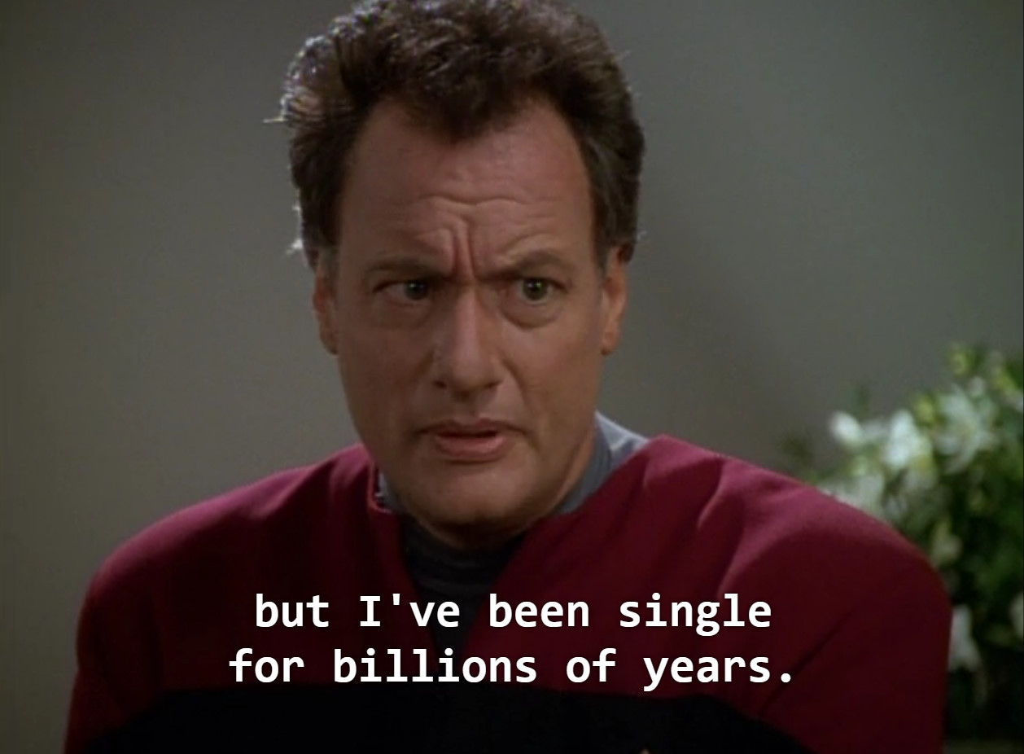
Round 1
THERE CAN BE ONLY 1
Q1
In Star Trek, who is this impish and omnipotent character who likes to tease Starfleet captains?

Slide 4
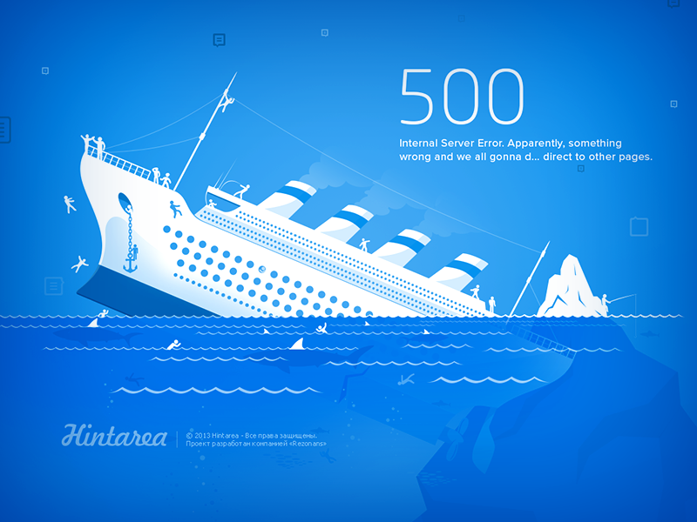
Round 1
THERE CAN BE ONLY 1
Q2
In Roman numerals, what letter represents 500?

Slide 5
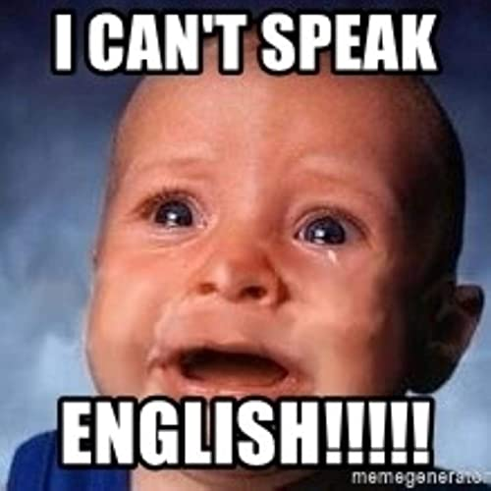
Round 1
THERE CAN BE ONLY 1
Q3
What’s the longest letter in the English alphabet when spelled?

Slide 6

Round 1
THERE CAN BE ONLY 1
Q4
What’s the letter used to name the series of vitamins including niacin and riboflavin?

Slide 7
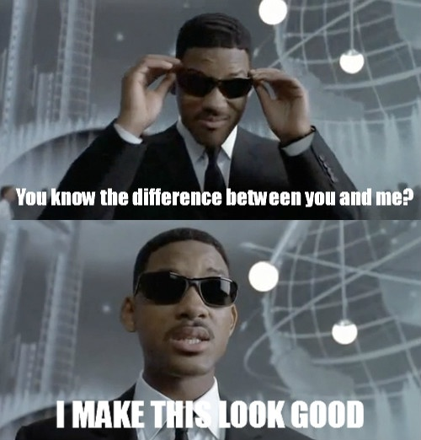
Round 1
THERE CAN BE ONLY 1
Q5
What’s the name of Will Smith’s character in the film “Men in Black”?

Slide 8
Round 1
Famous Fourths
These answers are all famous fourths.
5 questions total.

Slide 9
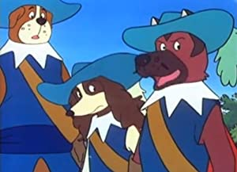
Round 1
Famous Fourths
Q6
Athos, Porthos and Aramis were the 3 musketeers. What was the name of their friend, who following the Siege of La Rochelle, became the "fourth musketeer"?

Slide 10
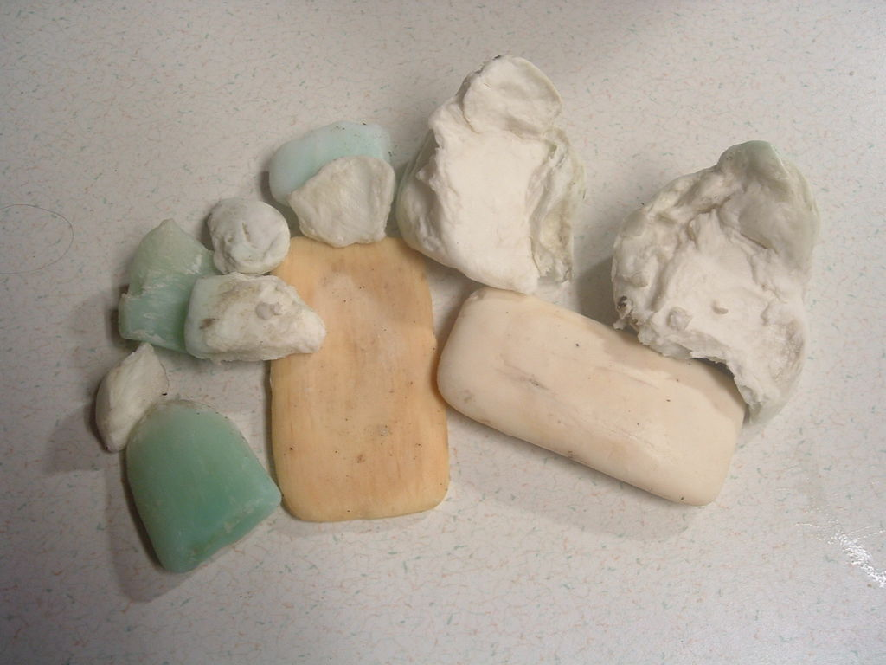
Round 1
Famous Fourths
Q7
Which is the fourth oldest TV soap to be aired in the UK, which is still running?

Slide 11
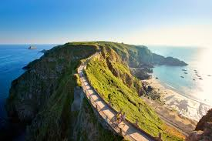
Round 1
Famous Fourths
Q8
By both population and area, what is the fourth largest Channel island?

Slide 12
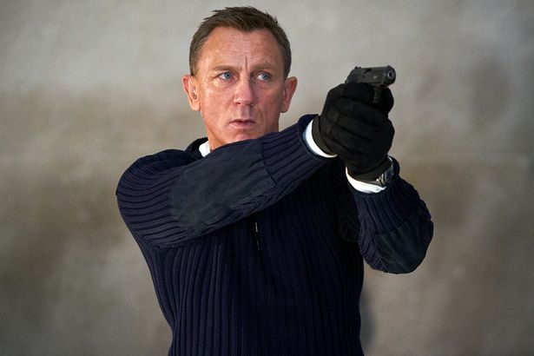
Round 1
Famous Fourths
Q9
What was the fourth James Bond film?

Slide 13
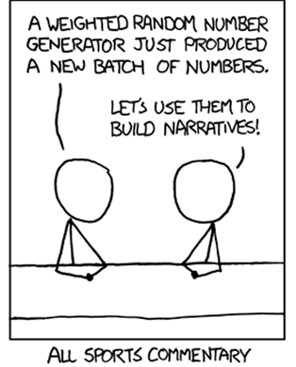
Round 1
Famous Fourths
Q10
In terms of revenue, what is the fourth largest major professional sports league in North America?

Slide 14
Round 1
THERE CAN BE ONLY 1
Q1
In Star Trek, who is this impish and omnipotent character who likes to tease Starfleet captains?

Slide 15
Round 1
THERE CAN BE ONLY 1
A1
Q

Slide 16
Round 1
THERE CAN BE ONLY 1
Q2
In Roman numerals, what letter represents 500?

Slide 17
Round 1
THERE CAN BE ONLY 1
A2
D

Slide 18
Round 1
THERE CAN BE ONLY 1
Q3
What’s the longest letter in the English alphabet when spelled?

Slide 19
Round 1
THERE CAN BE ONLY 1
A3
W

Slide 20
Round 1
THERE CAN BE ONLY 1
Q4
What’s the letter used to name the series of vitamins including niacin and riboflavin?

Slide 21
Round 1
THERE CAN BE ONLY 1
A4
B

Slide 22
Round 1
THERE CAN BE ONLY 1
Q5
What’s the name of Will Smith’s character in the film “Men in Black”?

Slide 23
Round 1
THERE CAN BE ONLY 1
A5
J

Slide 24
Round 1
Famous Fourths
A6
Athos, Porthos and Aramis were the 3 musketeers. What was the name of their friend, who following the Siege of La Rochelle, became the "fourth musketeer"?

Slide 25
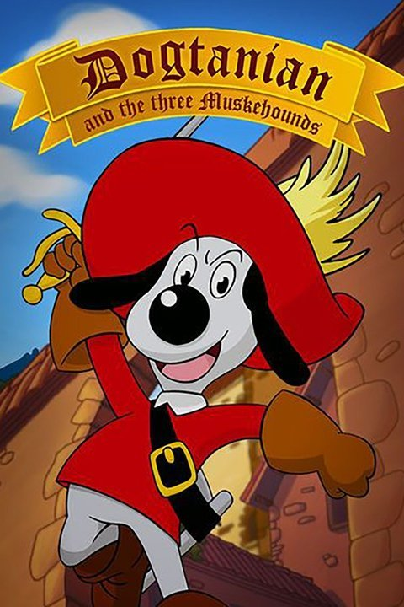
Round 1
Famous Fourths
A6
D'Artagnan

Slide 26
Round 1
Famous Fourths
A7
Which is the fourth oldest TV soap to be aired in the UK, which is still running?

Slide 27
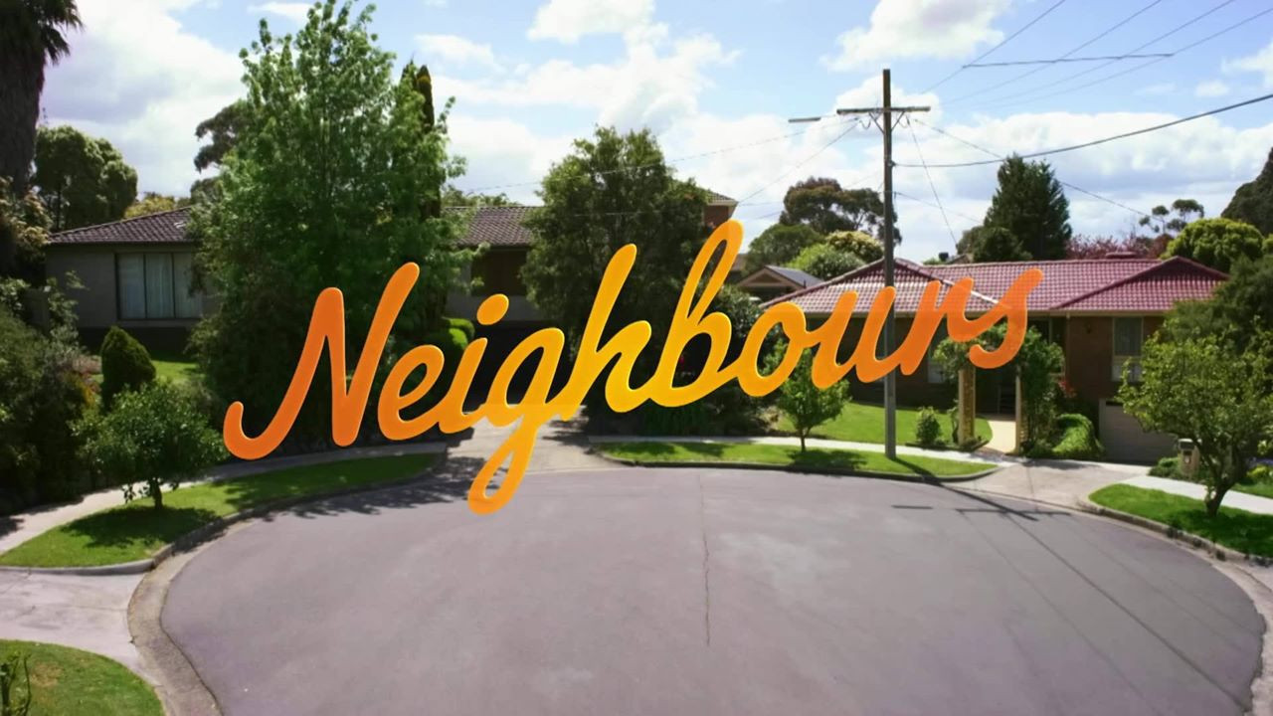
Round 1
Famous Fourths
A7
Neighbours
November 1986

Slide 28
Round 1
Famous Fourths
A8
By both population and area, what is the fourth largest Channel island?

Slide 29
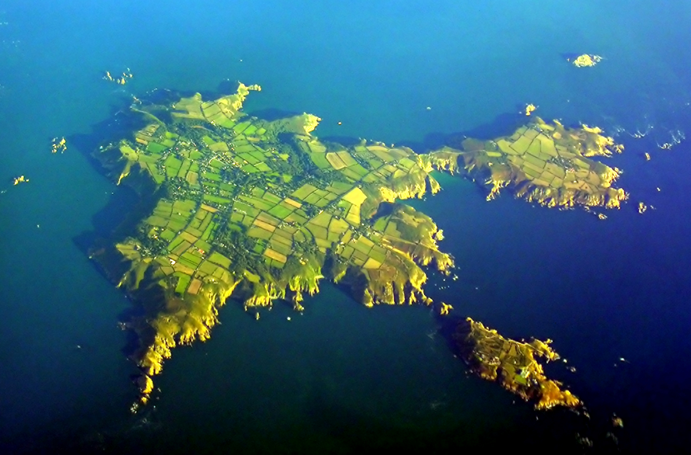
Round 1
Famous Fourths
A8
Sark

Slide 30
Round 1
Famous Fourths
A9
What was the fourth James Bond film?

Slide 31

Round 1
Famous Fourths
A9
Thunderball

Slide 32
Round 1
Famous Fourths
A10
In terms of revenue, what is the fourth largest major professional sports league in North America?

Slide 33

Round 1
Famous Fourths
A10
NHL with $3.7bn

Slide 34
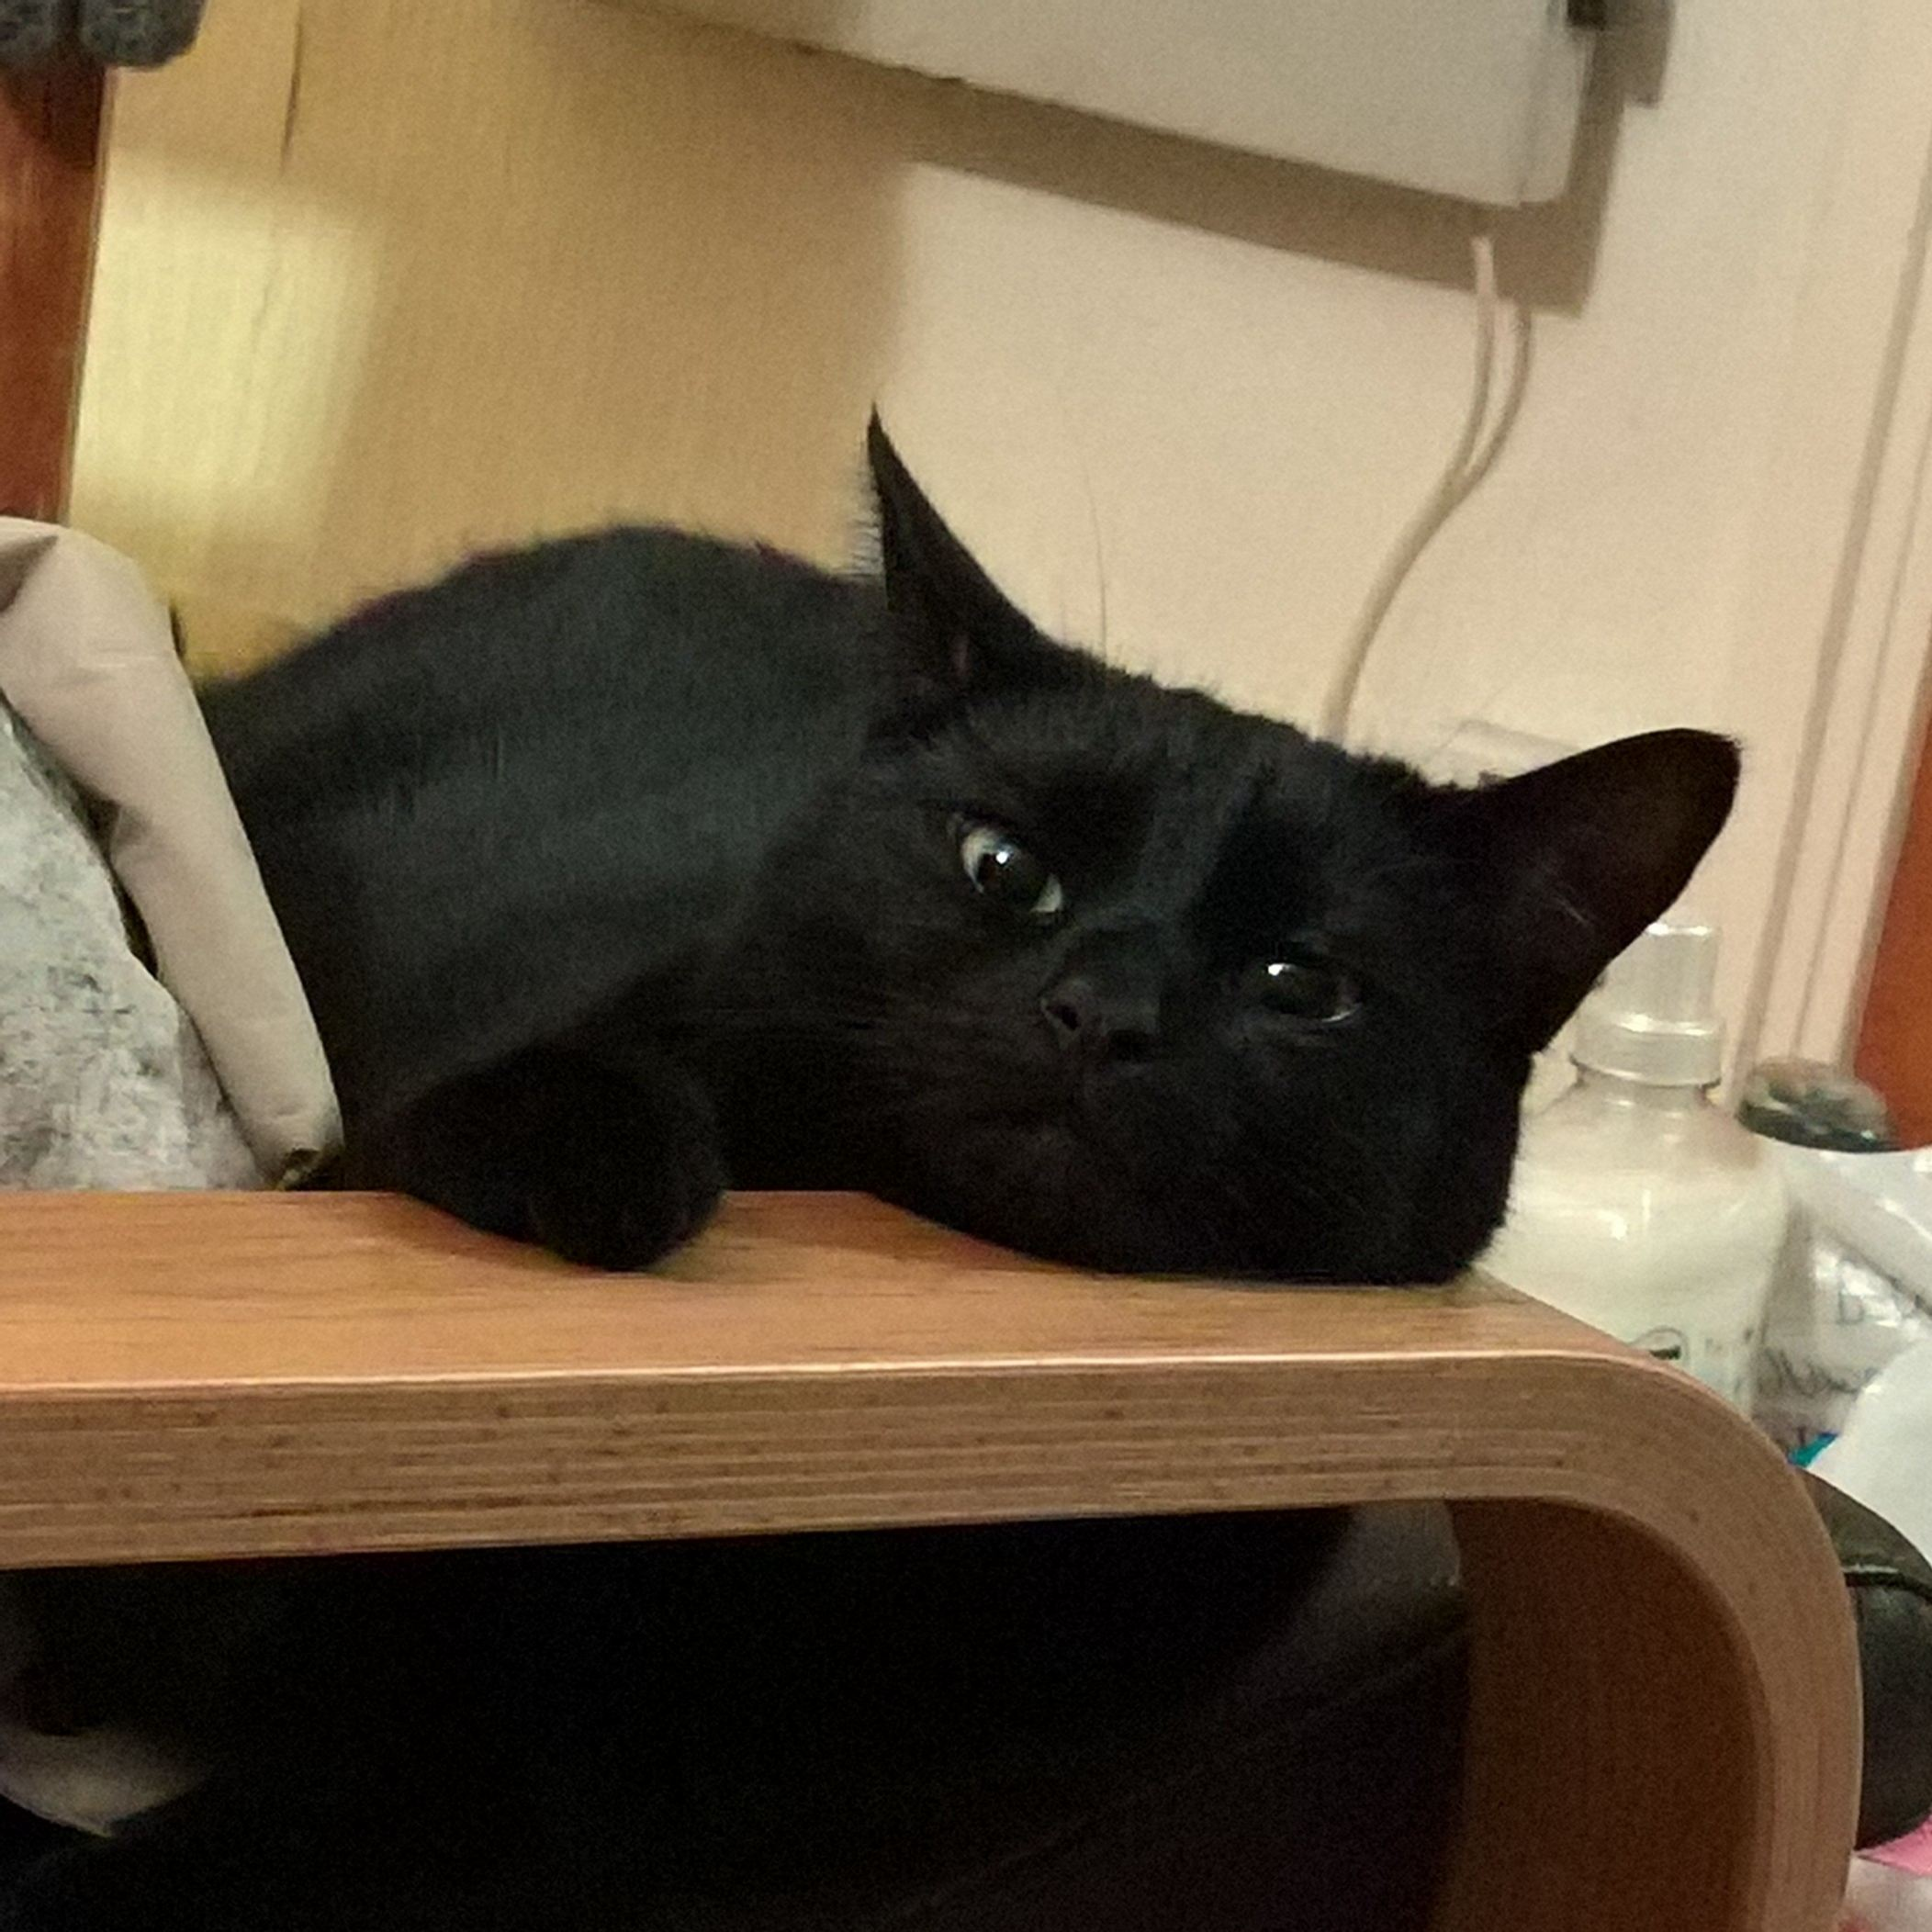
Round 2
GET INTO THE GROOVE
Q
Guess the NAME and the ARTIST of each of these 10 songs.
1 point per name.
1 point per artist.
The sound bite will be played TWICE only.

Slide 35
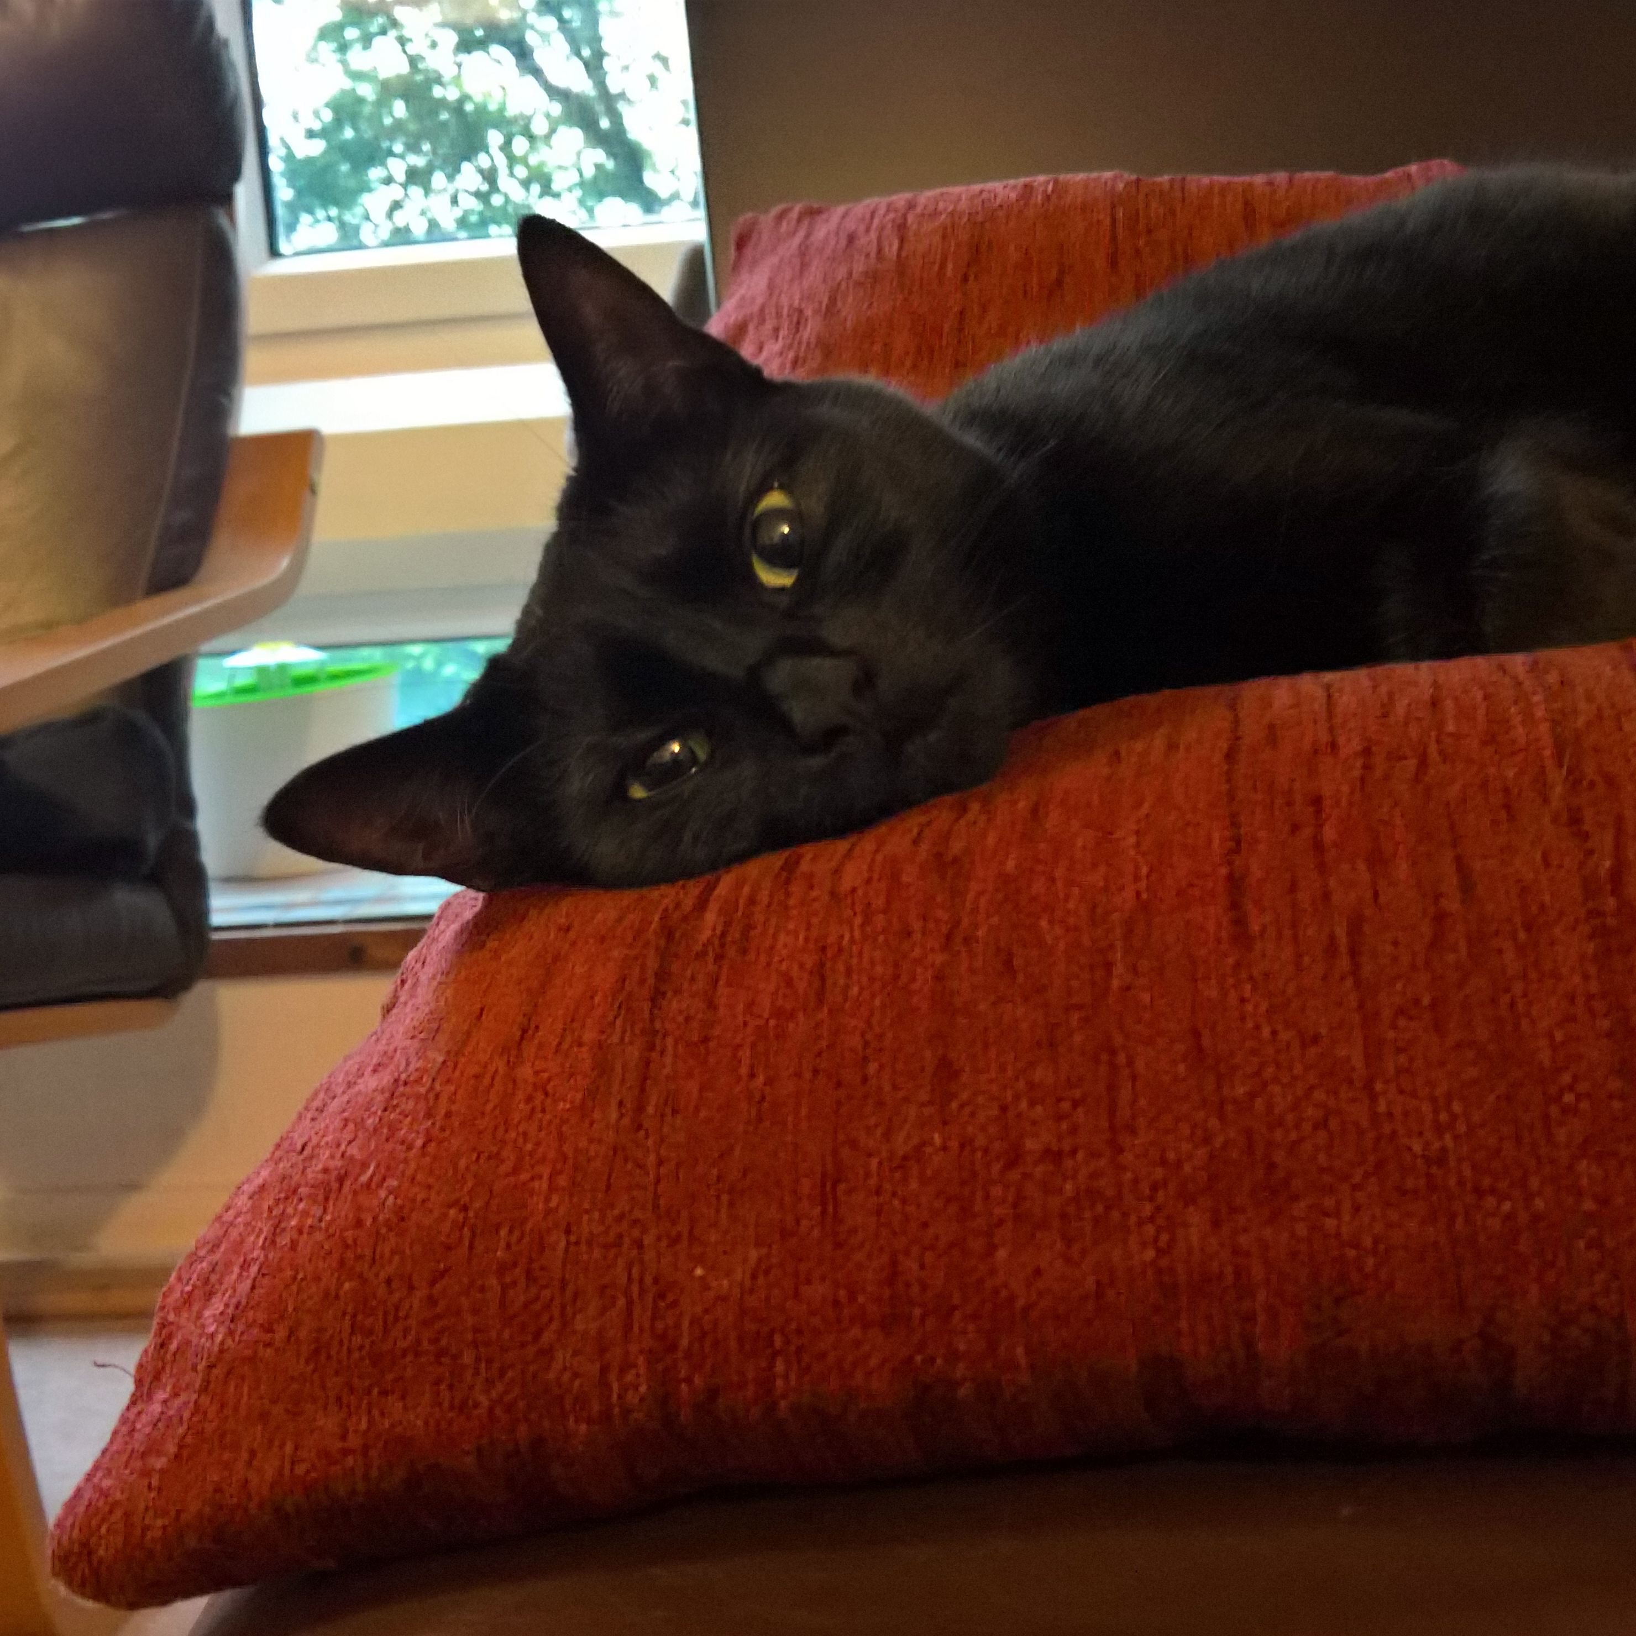
Round 2
GET INTO THE GROOVE
A
Ghostbusters - Ray Parker Jr
The Power Of Love - Huey Lewis And The News
9 to 5 - Dolly Parton
Footloose - Kenny Loggins
Twist And Shout - The Beatles
You’re The Best - Joe “Bean” Esposito
Axel F - Harold Faltermeyer
Flashdance… What A Feeling! - Irene Cara
Take My Breath Away - Berlin
Purple Rain - Prince

Slide 36
Round 3
WHO AM I?
You will be given a description of two people, who each share the same name. You must come up with what their name is.
5 questions only.

Slide 37
Round 3
WHO AM I?
Q1
She was married in 1582, when he was 18 and she was 26 years old.
The recipient of multiple awards, including an Academy Award, a Primetime Emmy Award, and a Golden Globe, she was one of the highest-paid actresses in the world in 2015.

Slide 38
Round 3
WHO AM I?
Q2
She has earned an Emmy Award, two Golden Globe Awards and a star on the Hollywood Walk of Fame.
She succeeded Anne Boleyn as queen consort following the latter's execution in May 1536

Slide 39
Round 3
WHO AM I?
Q3
Nicknamed "The King of Cool", his antihero persona developed at the height of the counterculture of the 1960s, and made him a top box-office draw during the 1960s and 1970s.
For his 2013 film 12 Years a Slave, he won an Academy Award, BAFTA Award for Best Film, and Golden Globe Award for Best Motion.

Slide 40
Round 3
WHO AM I?
Q4
He started his broadcasting career working for Piccadilly Radio, Manchester, as a teenager, before moving to London as a presenter for the BBC's Greater London Radio
He first gained attention in 2005 as the Marvel Comics character Human Torch, and later gained further worldwide attention for his portrayal of Steve Rogers / Captain America in the Marvel Cinematic Universe

Slide 41
Round 3
WHO AM I?
Q5
The philosopher and statesman served as Attorney General and as Lord Chancellor of England, and his works are credited with developing the scientific method.
The British figurative painter known for his emotionally charged raw imagery produced series of images of popes, crucifixions, and portraits of close friends, with abstracted figures sometimes isolated in geometrical cages, set against flat, nondescript backgrounds.

Slide 42
Round 3
WHO AM I?
A1
They were married in 1582, when he was 18 and she was 26 years old.
The recipient of multiple awards, including an Academy Award, a Primetime Emmy Award, and a Golden Globe, she was one of the highest-paid actresses in the world in 2015.

Slide 43
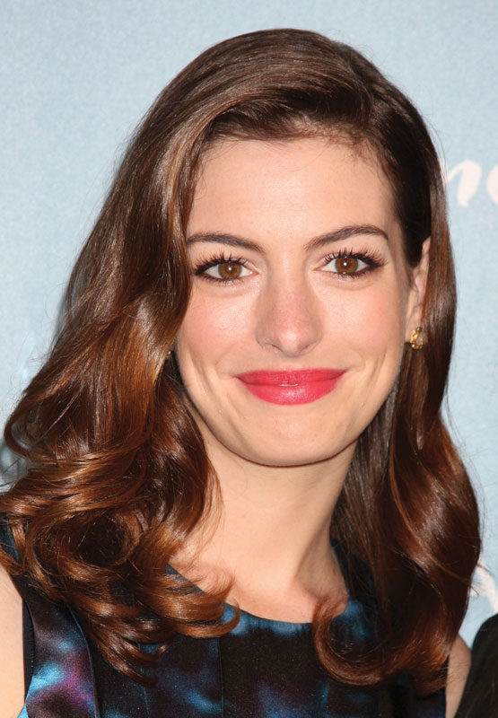
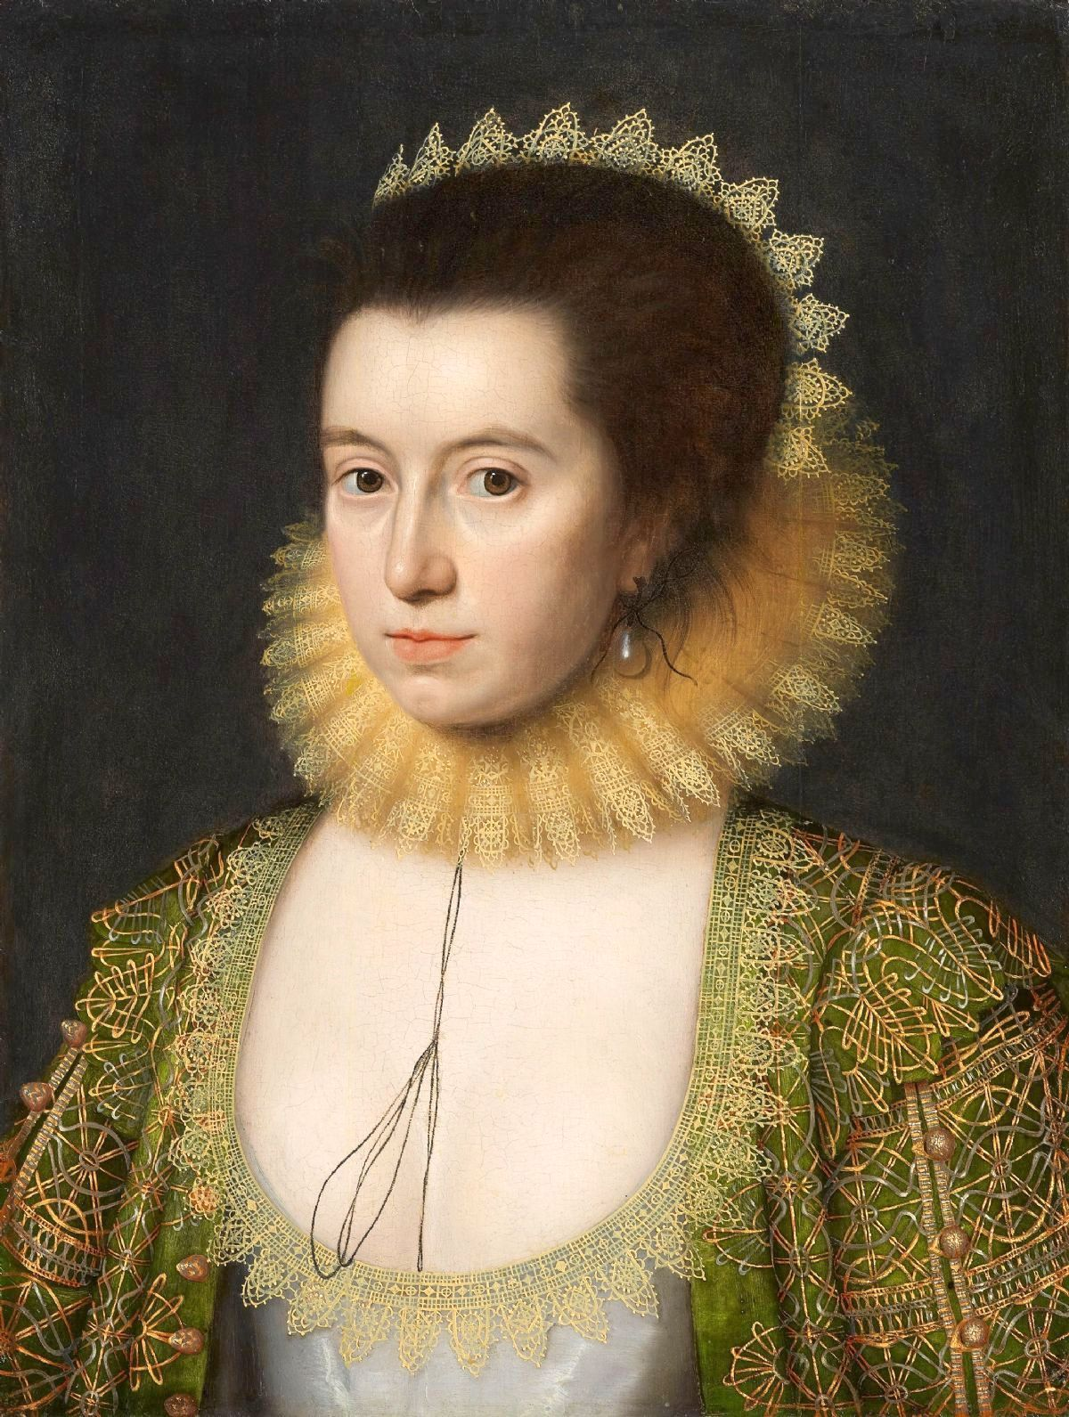
Round 3
WHO AM I?
A1
Anne Hathaway

Slide 44
Round 3
WHO AM I?
A2
She has earned an Emmy Award, two Golden Globe Awards and a star on the Hollywood Walk of Fame.
She succeeded Anne Boleyn as queen consort following the latter's execution in May 1536

Slide 45
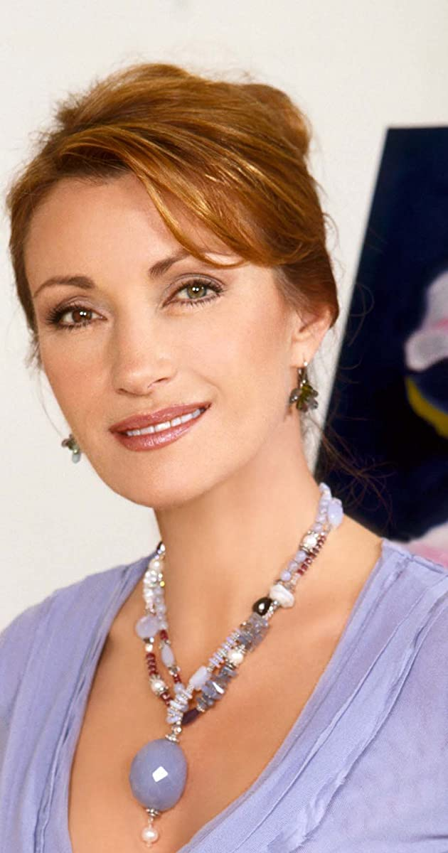
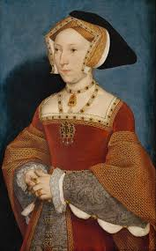
Round 3
WHO AM I?
A2
Jane Seymour

Slide 46
Round 3
WHO AM I?
A3
Nicknamed "The King of Cool", his antihero persona developed at the height of the counterculture of the 1960s, and made him a top box-office draw during the 1960s and 1970s.
For his 2013 film 12 Years a Slave, he won an Academy Award, BAFTA Award for Best Film, and Golden Globe Award for Best Motion.

Slide 47
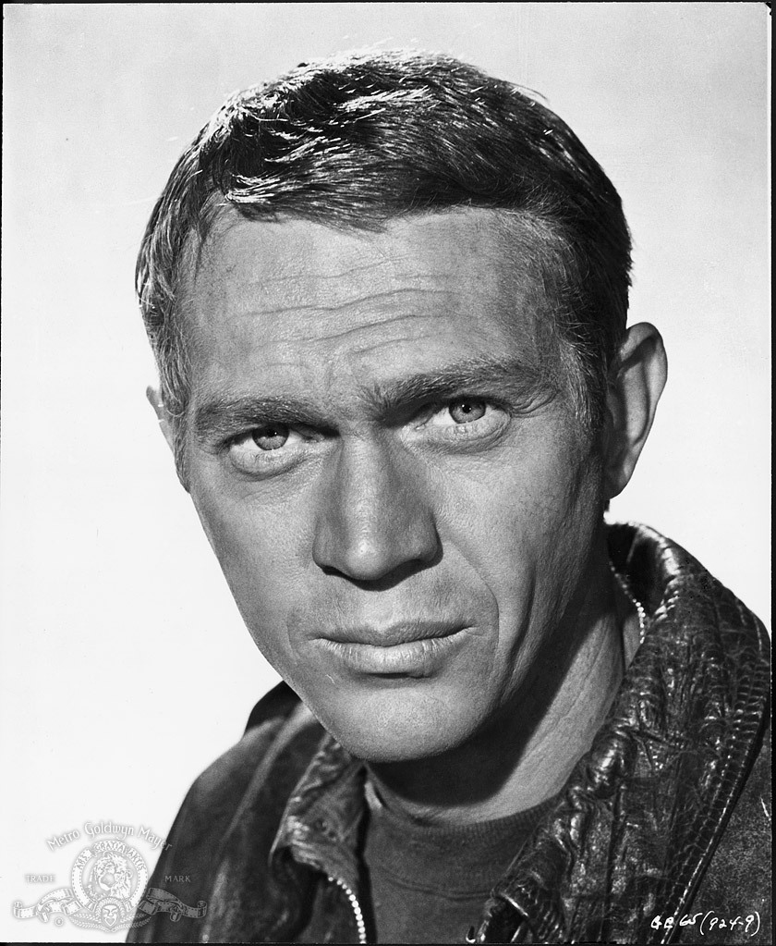
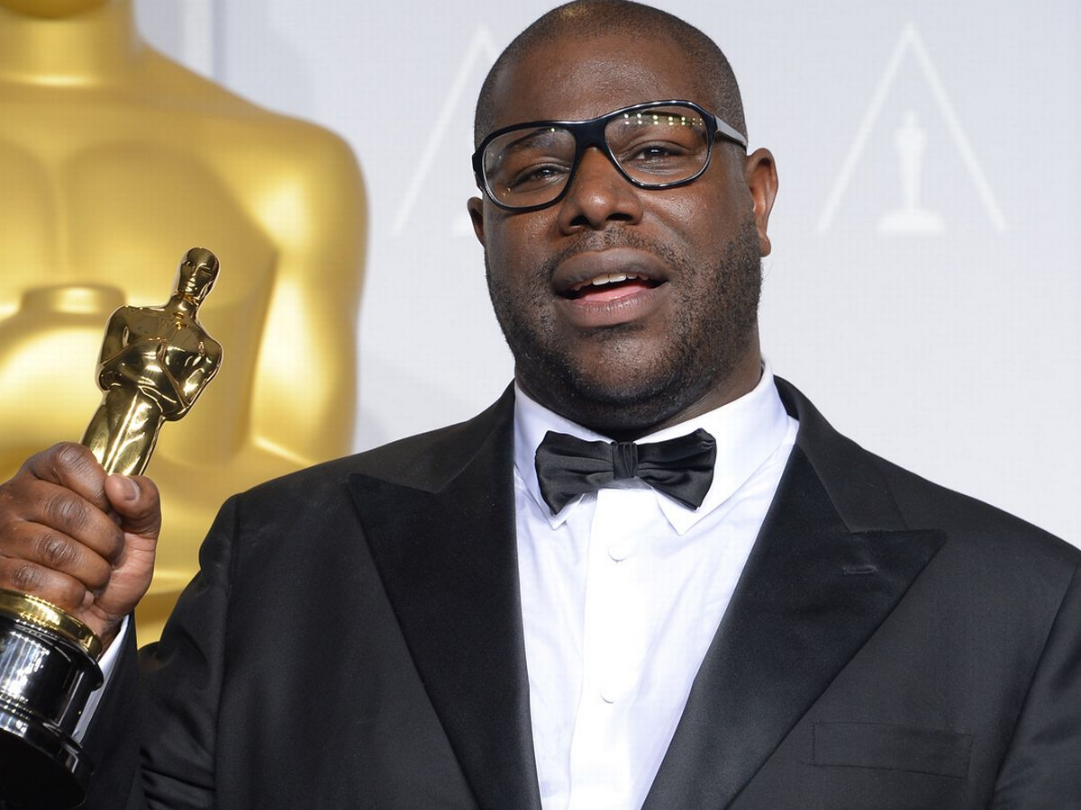
Round 3
WHO AM I?
A3
Steve McQueen

Slide 48
Round 3
WHO AM I?
A4
He started his broadcasting career working for Piccadilly Radio, Manchester, as a teenager, before moving to London as a presenter for the BBC's Greater London Radio
He first gained attention in 2005 as the Marvel Comics character Human Torch, and later gained further worldwide attention for his portrayal of Steve Rogers / Captain America in the Marvel Cinematic Universe

Slide 49
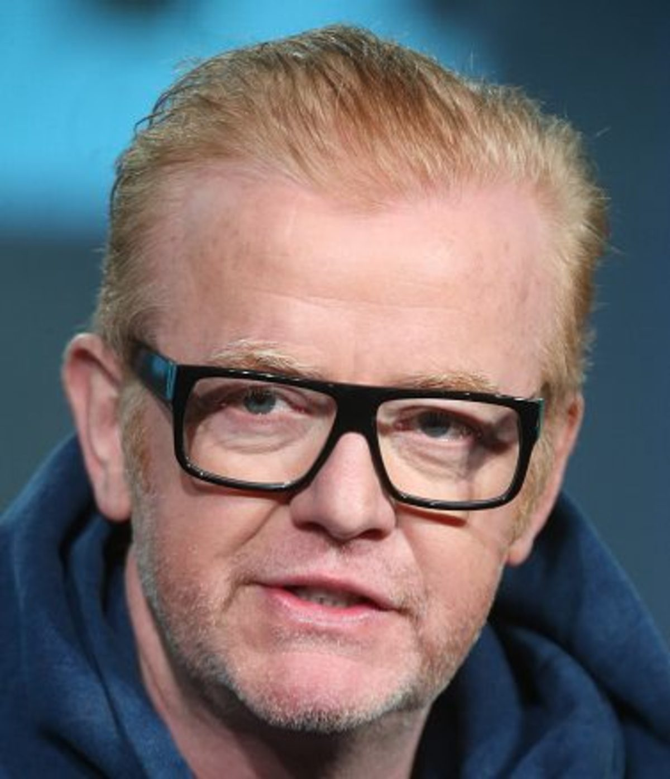
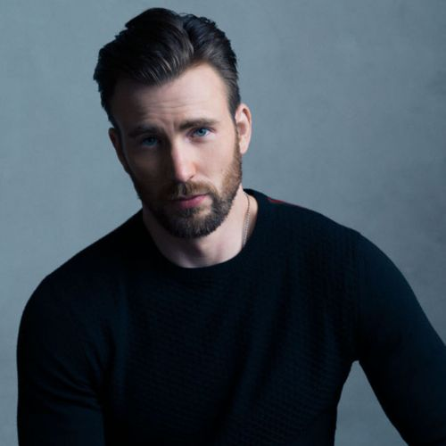
Round 3
WHO AM I?
A4
Chris Evans

Slide 50
Round 3
WHO AM I?
A5
The philosopher and statesman served as Attorney General and as Lord Chancellor of England, and his works are credited with developing the scientific method.
The British figurative painter known for his emotionally charged raw imagery produced series of images of popes, crucifixions, and portraits of close friends, with abstracted figures sometimes isolated in geometrical cages, set against flat, nondescript backgrounds.

Slide 51
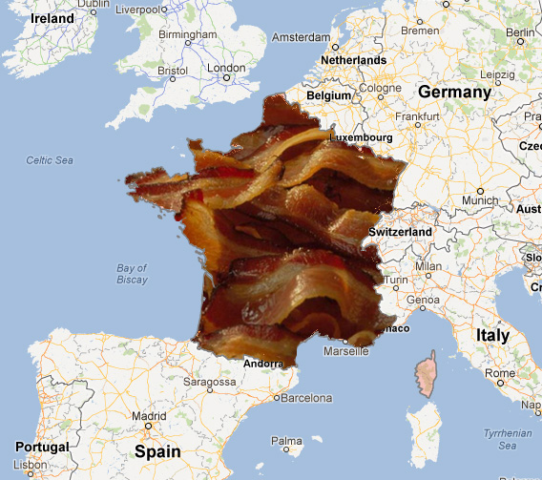
Round 3
WHO AM I?
A5
Francis Bacon

Slide 52
Round 4
What’s the Link?
You will receive five questions in this round.
There is a non-obvious link that connects them all – there are five bonus points for correctly guessing the link.
5 questions only, 10 points available.

Slide 53
Round 4
What’s the Link?
Q1
In which 2014 film does a character called Gary Unwin get recruited by a spy organisation, despite his being an unlikely candidate for the job?

Slide 54
Round 4
What’s the Link?
Q2
In which Beatles song will you find the line “Man you should have seen them kicking Edgar Allen Poe.”?

Slide 55
Round 4
What’s the Link?
Q3
Which mammal does not have a stomach?

Slide 56
Round 4
What’s the Link?
Q4
Who wrote a children’s book called “Fox in Socks”?

Slide 57
Round 4
What’s the Link?
Q5
Which comedic rap group from Newport, Wales has a member known as DJ Killer Tom?

Slide 58
Round 4
What’s the Link?
A1
In which 2014 film does a character called Gary Unwin get recruited by a spy organisation, despite his being an unlikely candidate for the job?

Slide 59
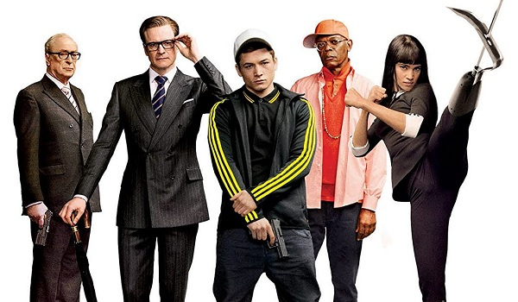
Round 4
What’s the Link?
A1
Kingsman: The Secret Service

Slide 60
Round 4
What’s the Link?
A2
In which Beatles song will you find the line “Man you should have seen them kicking Edgar Allen Poe.”?

Slide 61
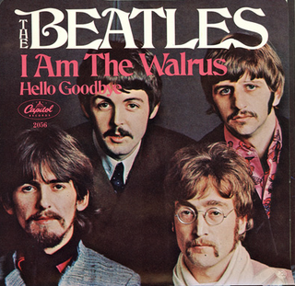
Round 4
What’s the Link?
A2
I am the Walrus

Slide 62
Round 4
What’s the Link?
A3
Which mammal does not have a stomach?

Slide 63
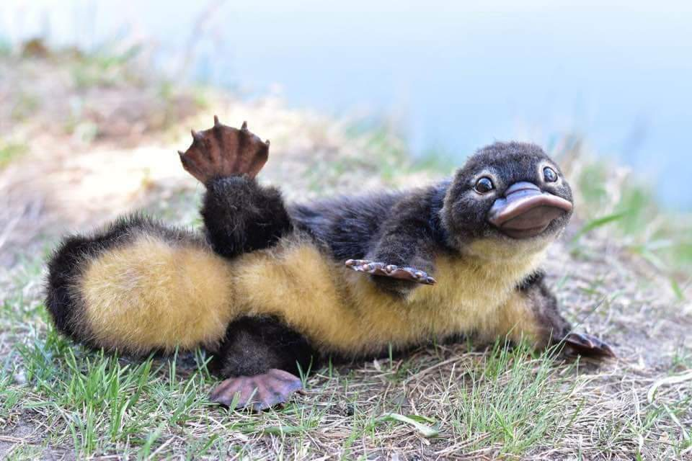
Round 4
What’s the Link?
A3
The Platypus

Slide 64
Round 4
What’s the Link?
A4
Who wrote a children’s book called “Fox in Socks”?

Slide 65

Round 4
What’s the Link?
A4
Dr. Seuss

Slide 66
Round 4
What’s the Link?
A5
Which comedic rap group from Newport, Wales has a member known as DJ Killer Tom?

Slide 67
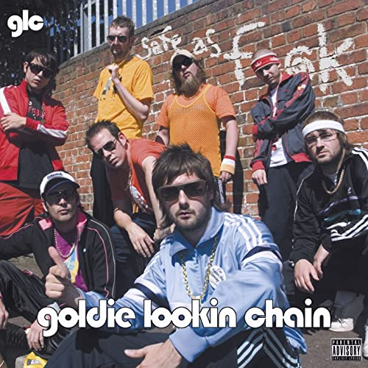
Round 4
What’s the Link?
A5
Goldie Lookin Chain

Slide 68
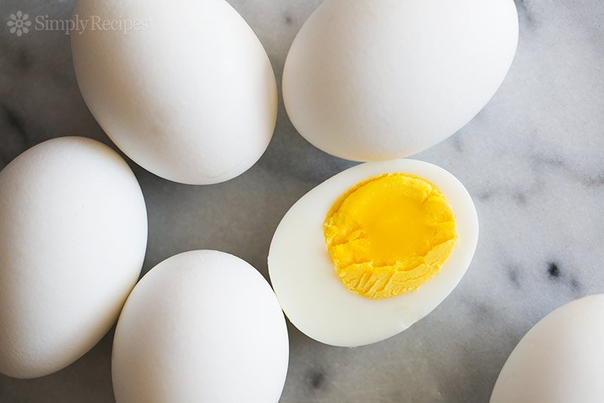
Round 4
What’s the Link?
A6
What’s the Link between these five questions?
Eggsy is the main character
I am the Eggman
Egg laying mammal
Green Eggs and Ham
Eggsy is a band member

Slide 69
Round 4
Riddles
Get your thinking caps on! It’s riddle time!
5 questions only

Slide 70
Round 4
Riddles
Q1
Only one colour, but not one size
Stuck at the bottom, yet easily flies
Present in sun, but not in the dark
Doing no harm, and leaving no mark
What am I?

Slide 71
Round 4
Riddles
Q2
if 11+2 = 1
then 9+5 = ?

Slide 72
Round 4
Riddles
Q3
David’s father has three sons: Snap, Crackle, and …?

Slide 73
Round 4
Riddles
Q4
How do you stop 7 being odd, without using any mathematical operations?

Slide 74
Round 4
Riddles
Q5
What has keys that open no locks, space but no room, and you can enter but not go in?

Slide 75
Round 4
Riddles
A1
Only one colour, but not one size
Stuck at the bottom, yet easily flies
Present in sun, but not in the dark
Doing no harm, and leaving no mark
What am I?

Slide 76
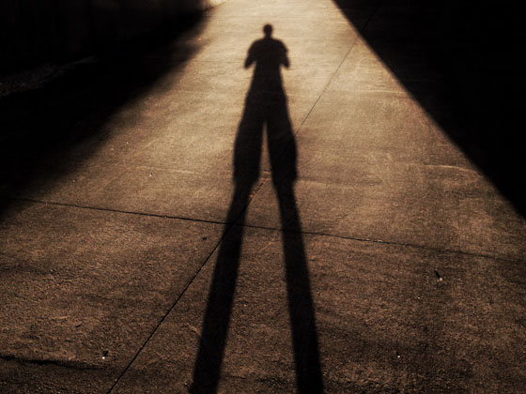
Round 4
Riddles
A1
A Shadow

Slide 77
Round 4
Riddles
A2
if 11+2 = 1
then 9+5 = ?

Slide 78

Round 4
Riddles
A2
2

Slide 79
Round 4
Riddles
A3
David’s father has three sons: Snap, Crackle, and …?

Slide 80
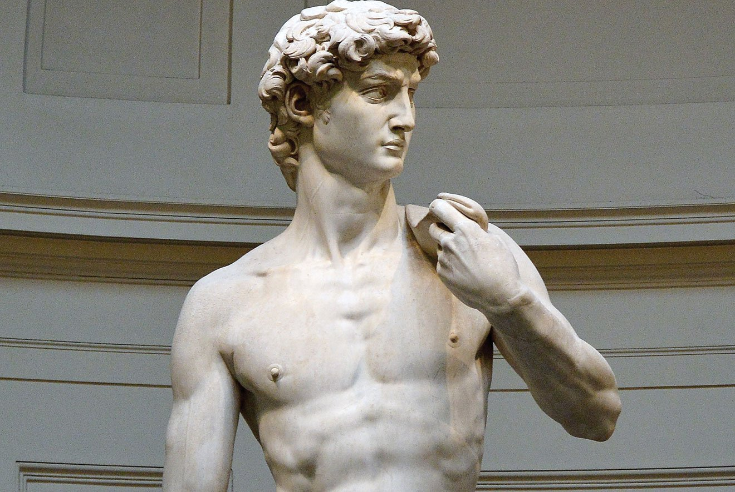
Round 4
Riddles
A3
David

Slide 81
Round 4
Riddles
A4
How do you stop 7 being odd, without using any mathematical operations?

Slide 82
Round 4
Riddles
A4
S
EVEN

Slide 83
Round 4
Riddles
A5
What has keys that open no locks, space but no room, and you can enter but not go in?

Slide 84

Round 4
Riddles
A5
A keyboard!

Slide 85
Round 5
Emojis + Agatha Christie
Emojis will pictographically show the name of an Agatha Christie novel, you need to work out what the book title is.
5 questions only

Slide 86

Emoji Example
Round 5
The aim of this round is to figure out the name of the Agatha Christie book from the emoji shown.

Slide 87
Emoji
Round 5
The aim of this round is to figure out the name of the Agatha Christie book from the emoji shown.
A Death in the Clouds

Slide 88

Emoji
Round 5
Q1

Slide 89

Emoji
Round 5
Q2

Slide 90

Emoji
Round 5
Q3

Slide 91

Emoji
Round 5
Q4

Slide 92

Emoji
Round 5
Q5

Slide 93
Emoji
Round 5
A1

Slide 94
Emoji
Round 5
A1
The Seven Dials Mystery

Slide 95
Emoji
Round 5
A2

Slide 96
Emoji
Round 5
A2
The Mysterious Affair at Styles

Slide 97
Emoji
Round 5
A3

Slide 98
Emoji
Round 5
A3
Murder on the Links

Slide 99
Emoji
Round 5
A4

Slide 100
Emoji
Round 5
A4
The Body in the Library

Slide 101
Emoji
Round 5
A5

Slide 102
Emoji
Round 5
A5
The Moving Finger

Slide 103
THE END

